Slide 1

Applied Cryptography
SHA Implementation
Done by :
Ramnarayanan Sankar - 801409708
Poojitha Jayareddygari - 801426875
Shashank Kolluru - 801421839

Slide 2
PROBLEM STATEMENT
Improving the performance of the SHA program which is written in C.

Slide 3
OVERVIEW OF THE FILES ATTACHED IN THE ZIP FOLDER
shaO.c - Original File which was given by Professor.
shaM.c - Modified File which contains the Optimized C program Code.
README.txt – This Readme File contains the Details of the Program in Depth.

Slide 4
How to Run the shaM.c program ?
There are two Steps for the Running the shaM.c file program:
Step 1: Compilation Part for shaM.c file
Give the command as gcc shaM.c -o programM
where,
shaM is the C program file.
programM is the Compiled File.
Step 2: Execution Part for shaM.c file
Give the command as ./programM
where,
programM is the file which is going to show output.

Slide 5
How to Run the shaO.c program ?
There are two Steps for the Running the shaO.c file program:
Step 1: Compilation Part for shaO.c file
Give the command as gcc shaO.c -o programO
where,
shaO is the C program file.
programO is the Compiled File.
Step 2: Execution Part for shaO.c file
Give the command as ./programO
where,
programO is the file which is going to show output.

Slide 6
How we approached the Optimization for the program ?
When we Saw the program, We decided to change only the FOR Loops.
Because Loops has O(n) Time Complexity and Function blocks without the Looping Statements is going to have O(1).
Where ‘(1)' Constant time taken for running the Function block
Where ‘(n)' represents the Number of times the loop is going to run.

Slide 7
What we did in the program to get the Optimized one ?
We removed For Loops from the functions in the program.
We then manually run the looping statements as the number of times required for the function Block of the program.
Finally, We reduced the Running time of the program.

Slide 8
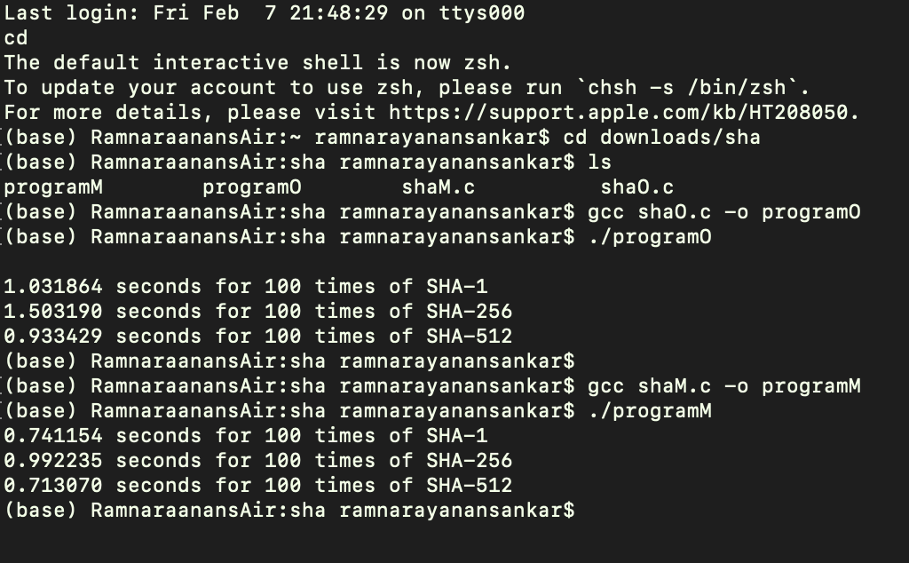
SOURCE CODE RUNTIME BEFORE AND AFTER THE CHANGES

Slide 9
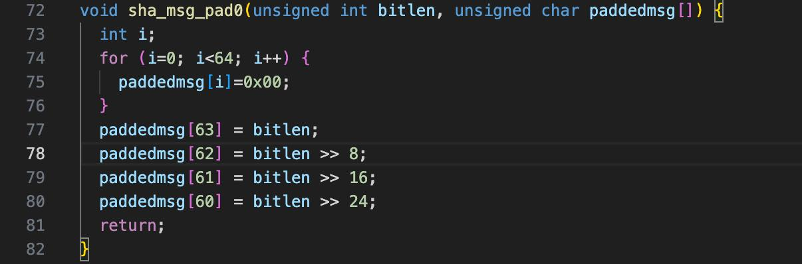
Source Code before changes -
void sha_msg_pad0
The 74 to 76 lines are commented and modified

Slide 10
Source Code after changes -
void sha_msg_pad0
Line 77 to line 140 has been added in the file shaM.c

Slide 11
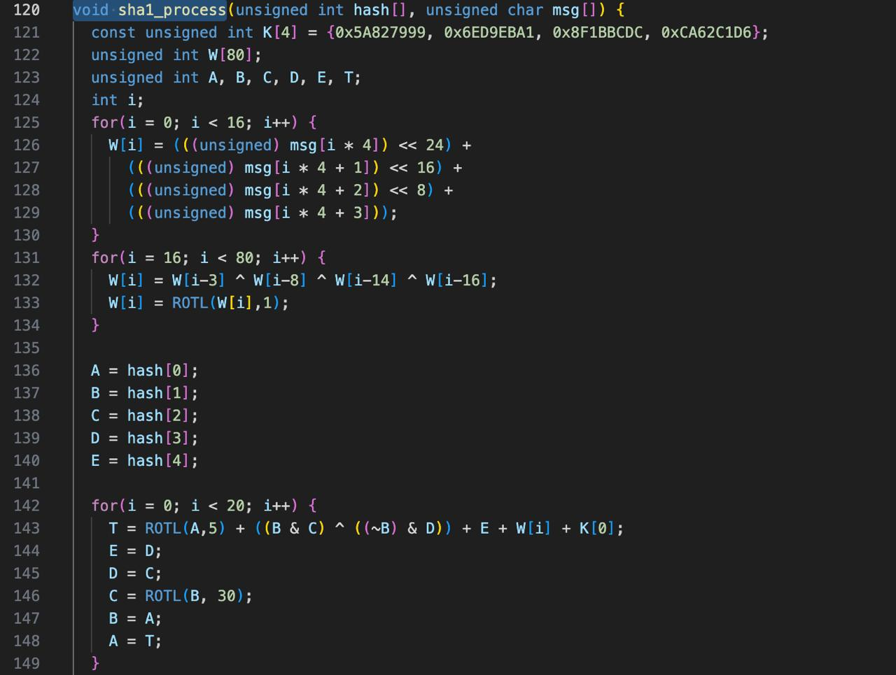
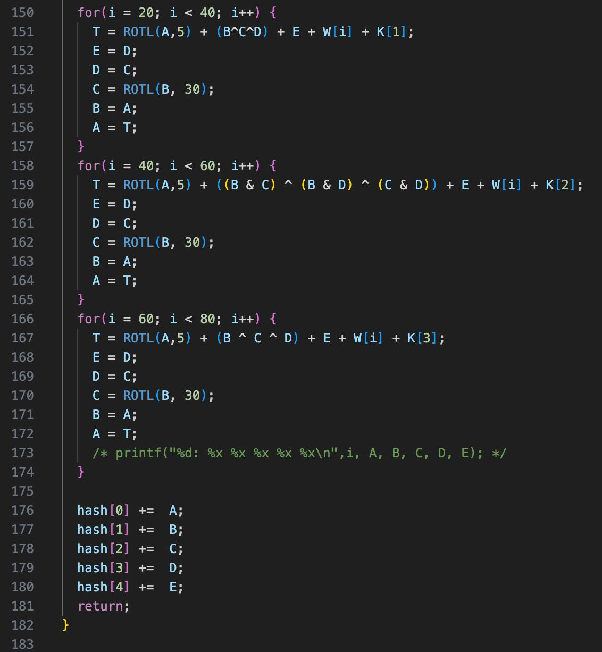
Source Code before changes -
void sha1_process

Slide 12
Source Code after changes -
void sha1_process
Line 197 to line 1070 has been added in the file shaM.c

Slide 13
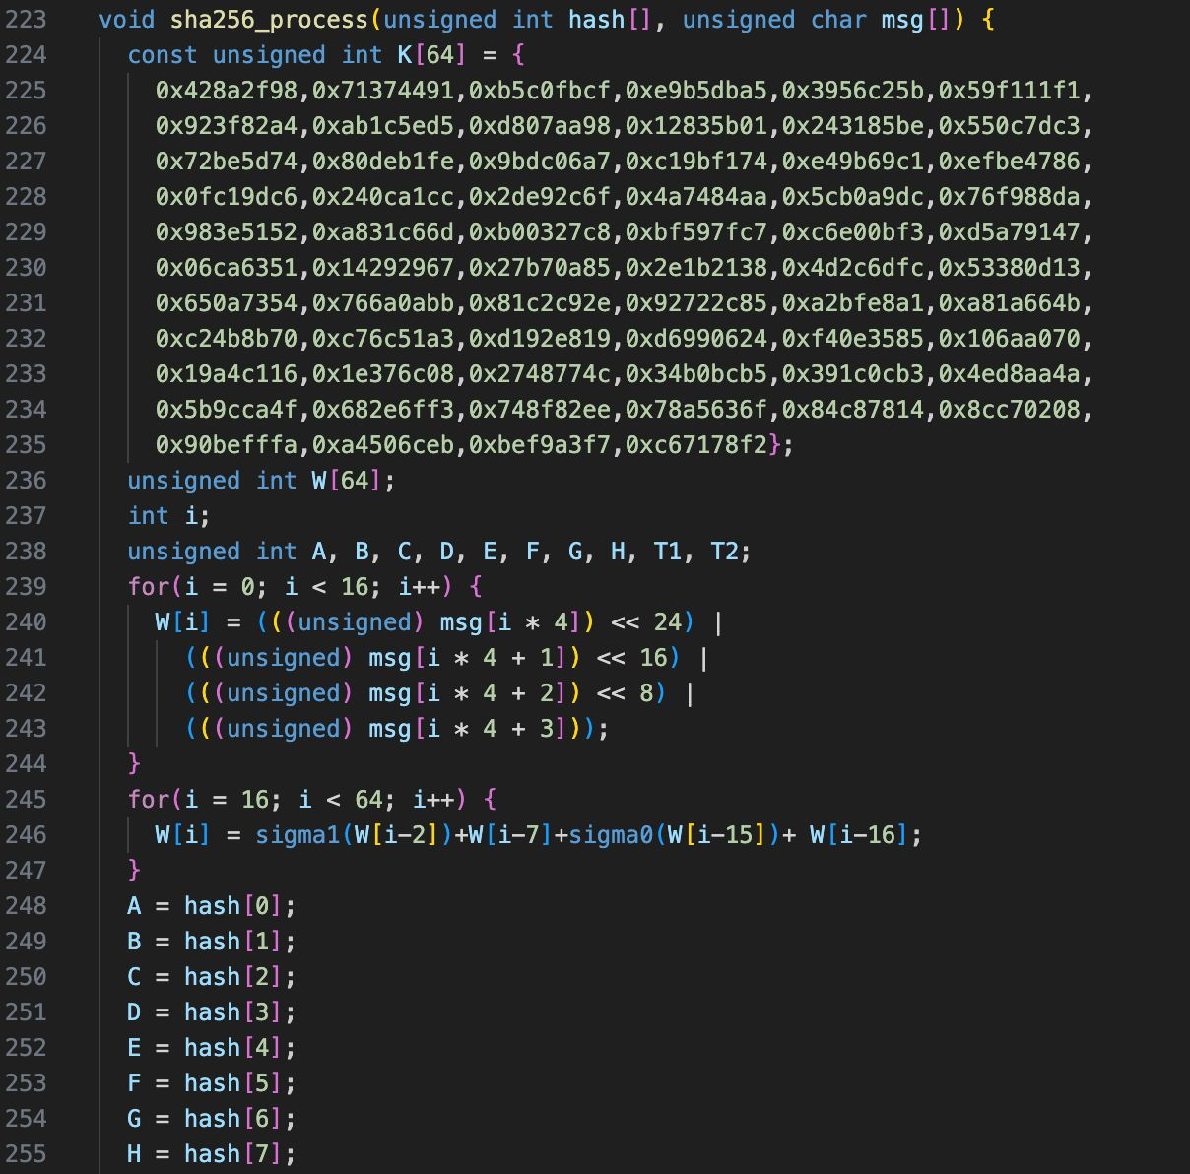
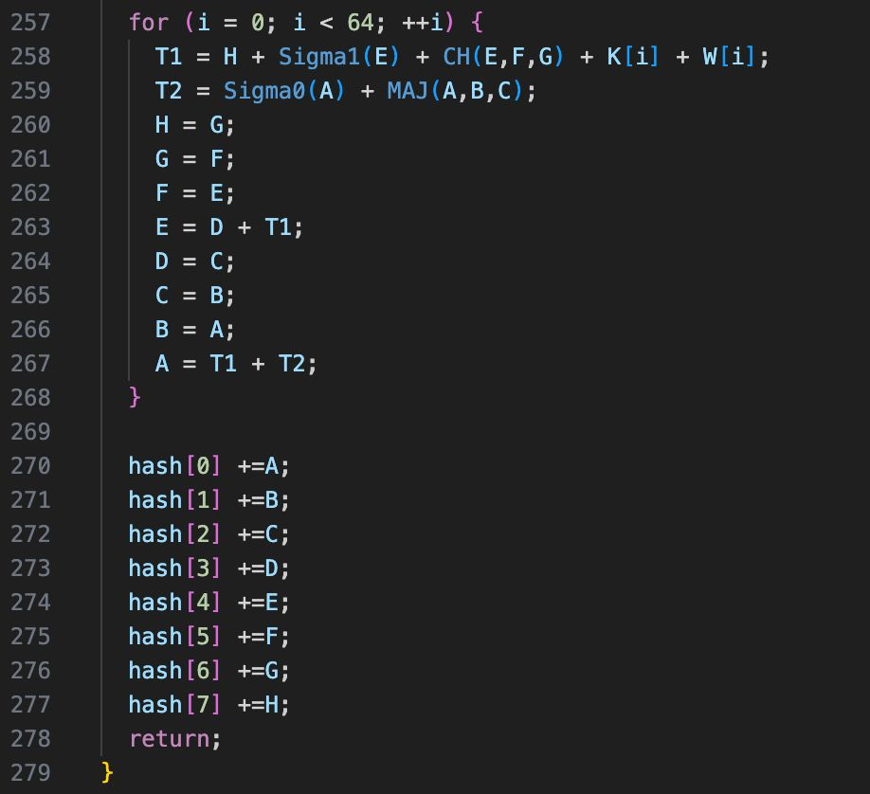
Source Code before changes -
void sha256_process

Slide 14
Source Code after changes -
void sha256_process
Line 1133 to line 1987 has been added in the file shaM.c

Slide 15
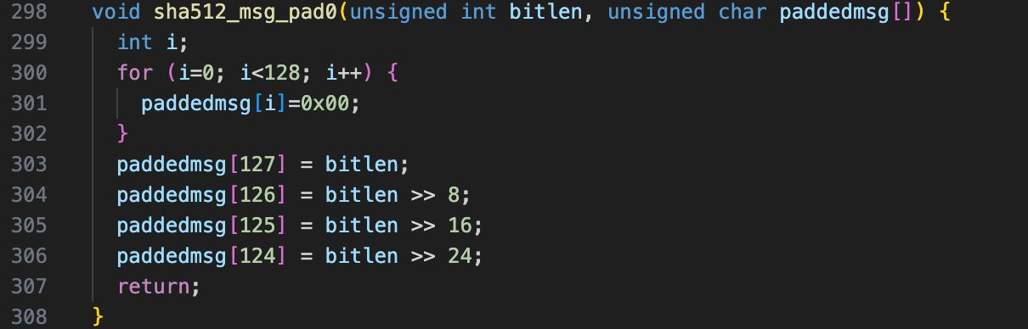
Source Code before changes -
sha512_msg_pad0

Slide 16
Source Code after changes -
sha512_msg_pad0
Line 2011 to line 2144 has been added in the file shaM.c

Slide 17
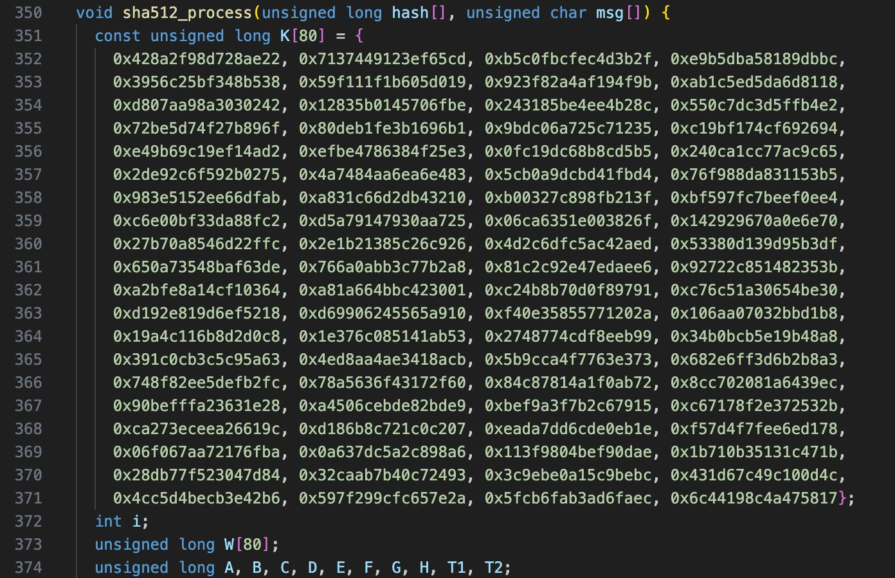
Source Code before changes -
void sha512_process

Slide 18
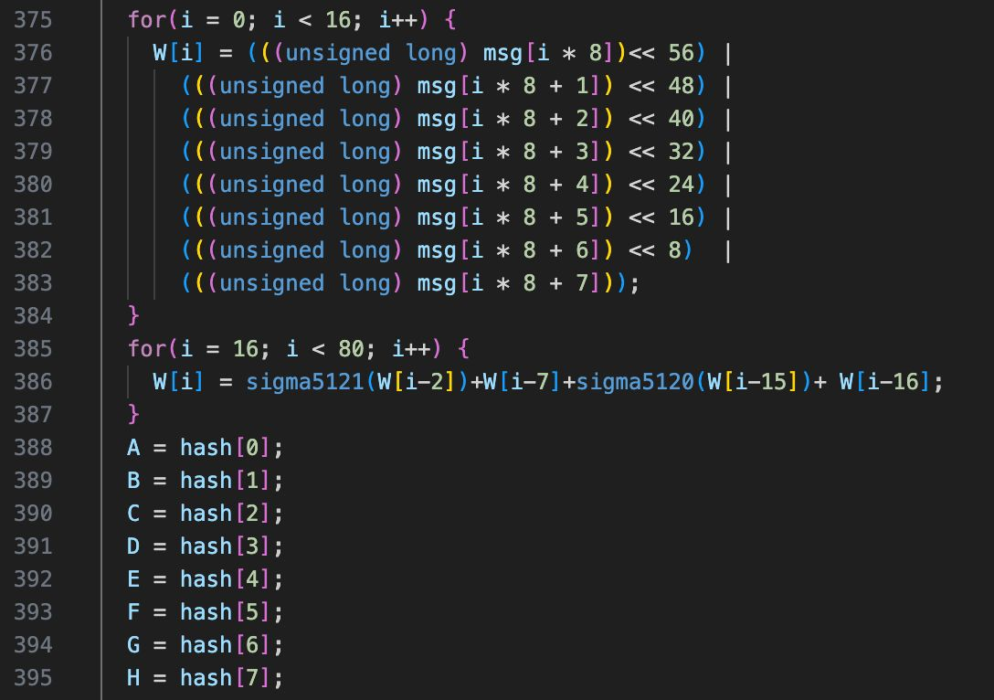
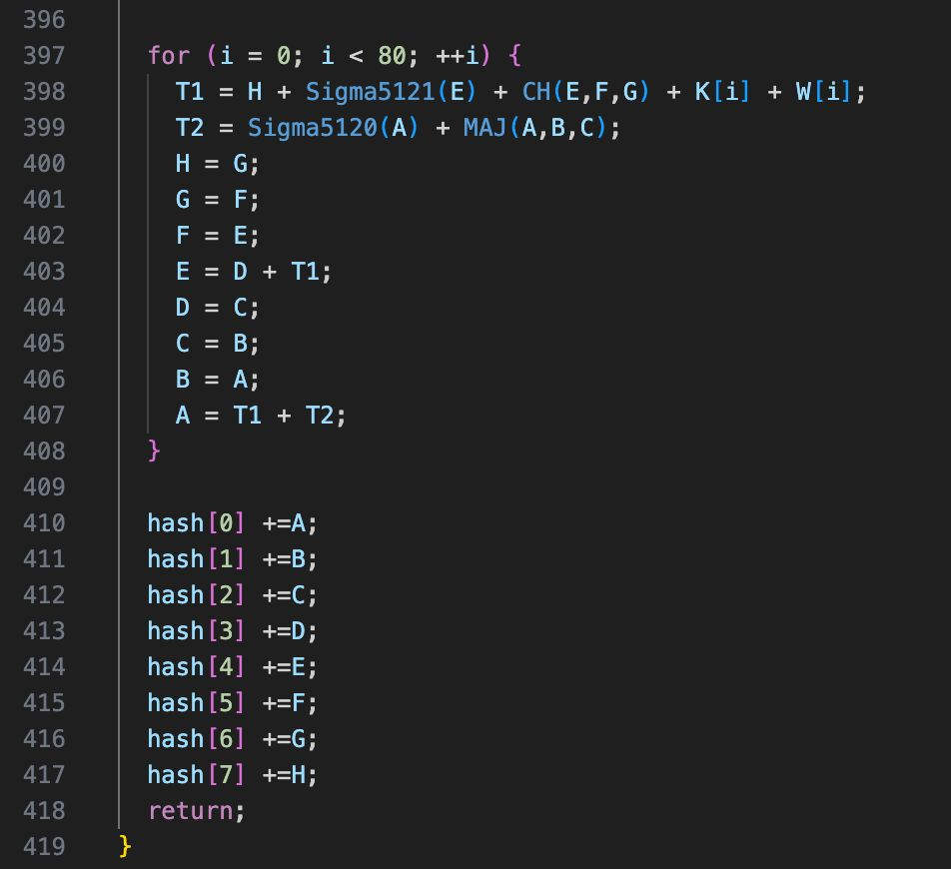

Slide 19
Source Code after changes -
void sha512_process
Line 2225 to line 3201 has been added in the file shaM.c

